Slide 1
ELEC5566M FPGA Design for System-on-Chip
Unit 1.1
Prof Steven Freear Module Leader s.freear@leeds.ac.uk
Dr David Cowell

Slide 2
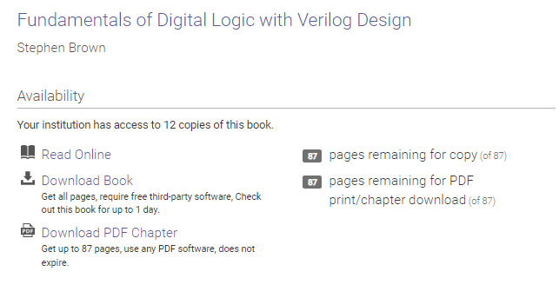

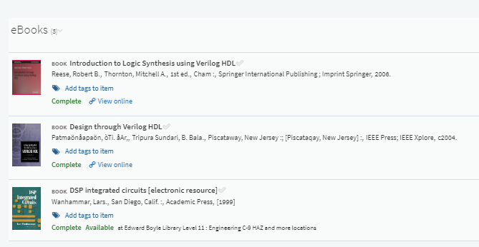

Reading List - reminder

Slide 3
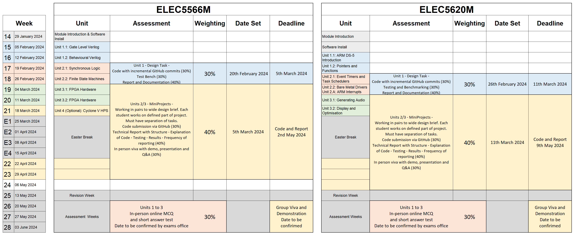
Assessment Summary – ELEC5566 Assessment Summary

Slide 4
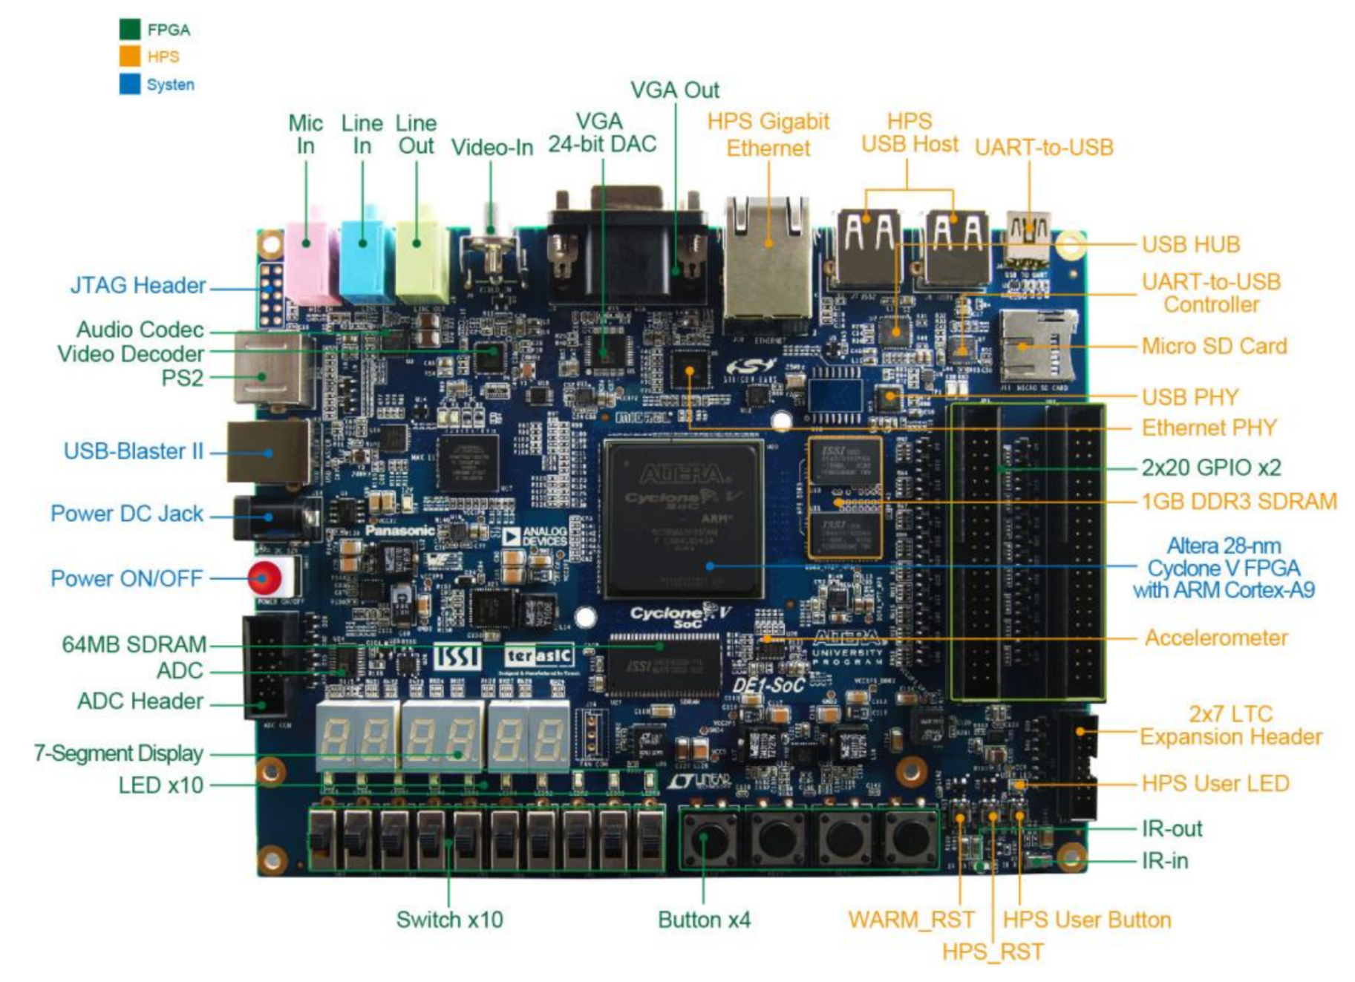
DE1-SoC
Source:
DE1-SoC User Manual
2015.08.05

Slide 5
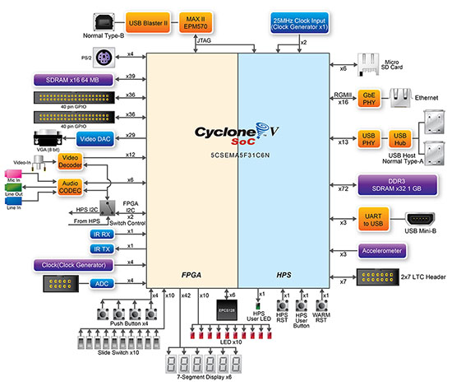
DE1-SoC
Source:
DE1-SoC User Manual
2015.08.05

Slide 6
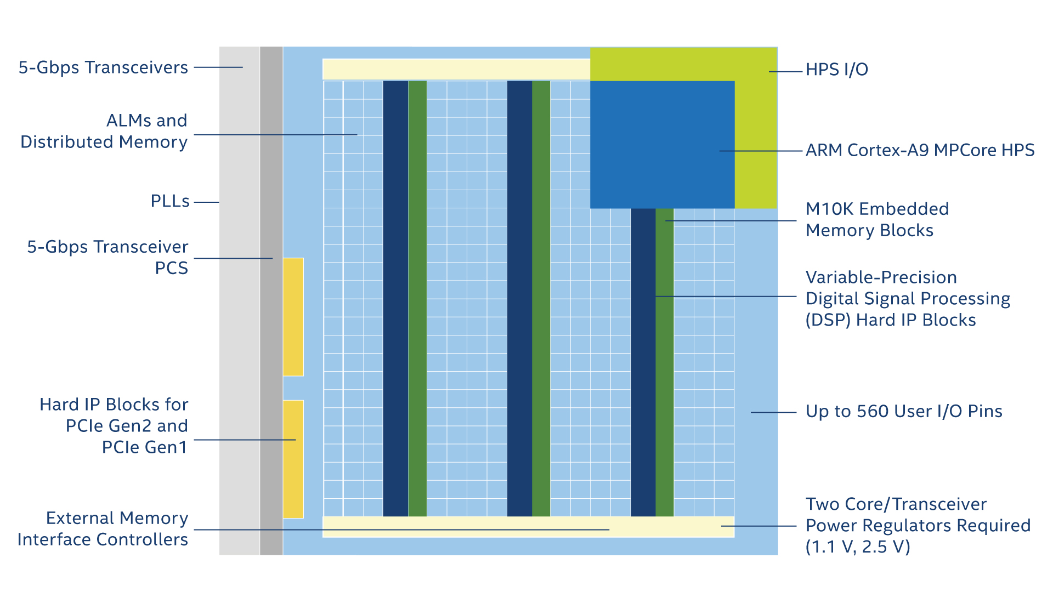
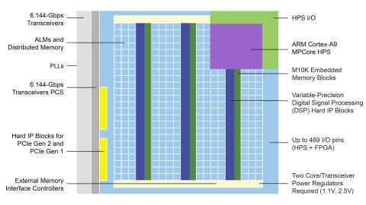
FPGA HPS – System-on-Chip
32k
6
4M bits
87 18x18 multipliers
Source:
https://www.intel.co.uk/content/www/uk/en/products/programmable/fpga/cyclone-v/features.html
2020.01.10

Slide 7
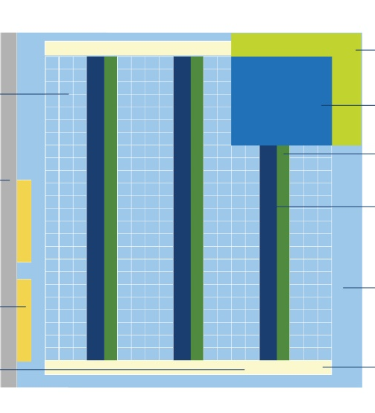
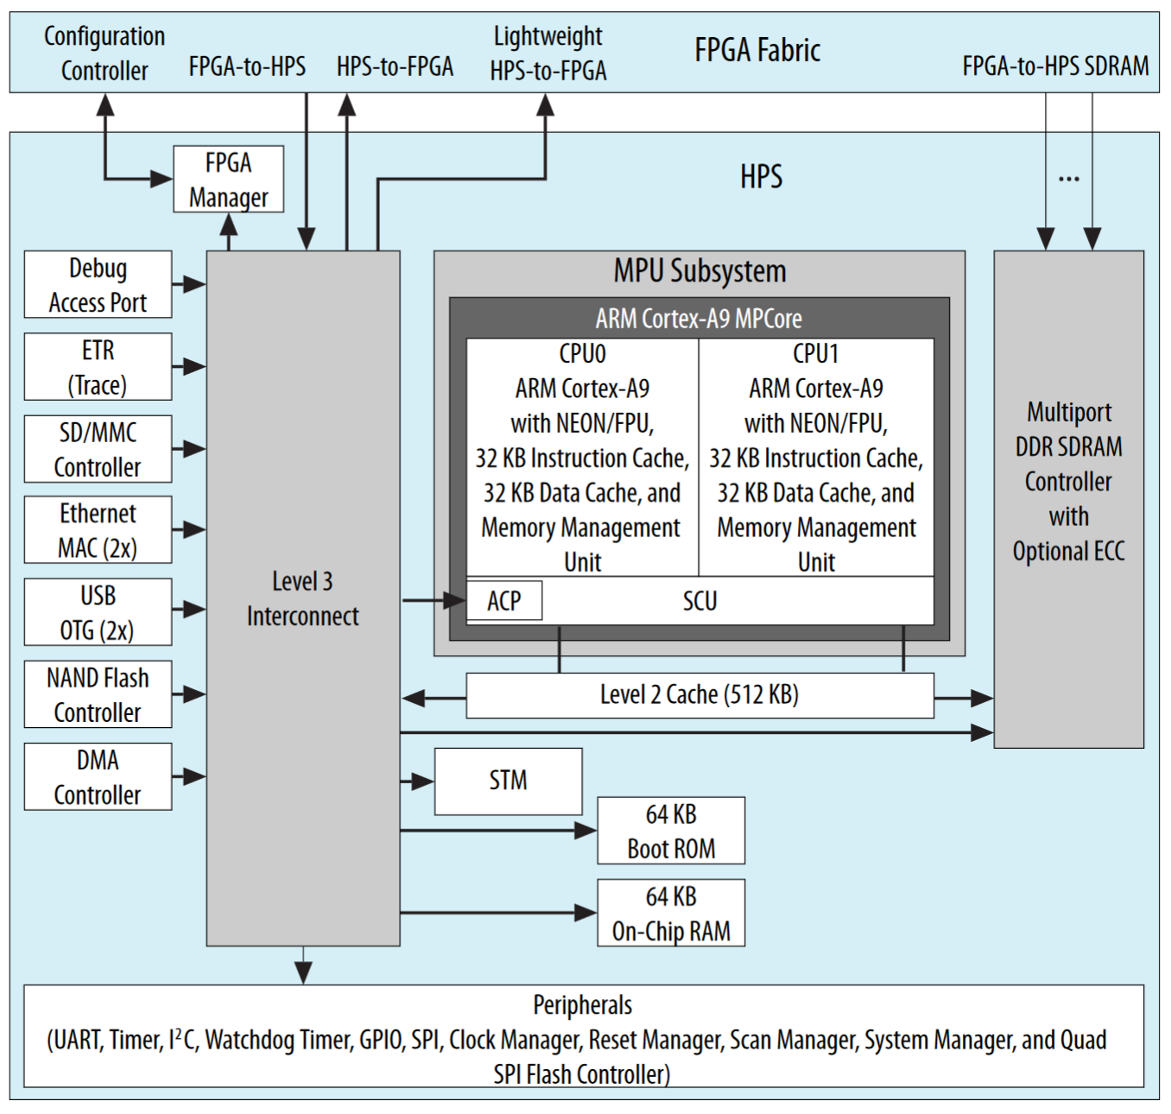
Cyclone V SoC Hard Processor System - ARM Cortex-A9
Source:
Cyclone V Device Overview CV-51001 | 2018.05.07

Slide 8
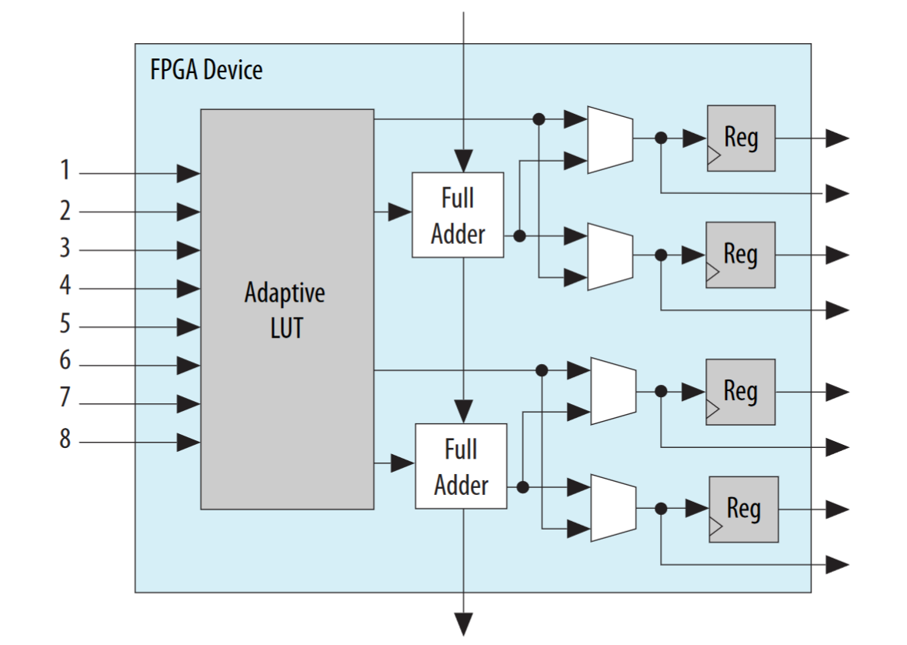
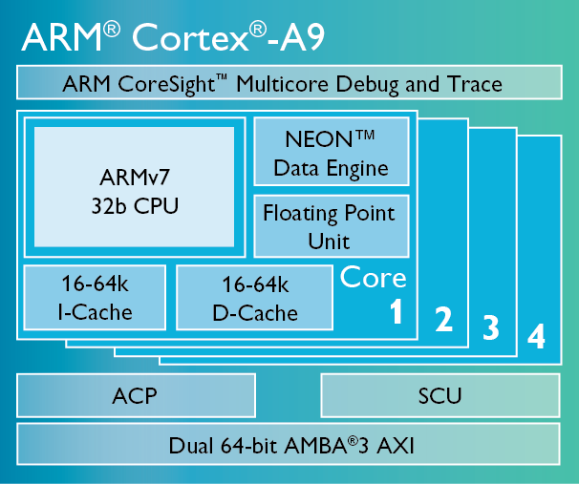
Cyclone V SoC FPGA Adaptive Logic Module (ALM)
x32k
In 1 | 2 | 3 | 4 | 5 | 6 | 7 | 8 | Out 1 | Out 2
0 | 0 | X | X | X | X | X | X | 0 | 0
0 | 1 | X | X | X | X | X | X | 1 | 1
1 | 0 | X | X | X | X | X | X | 1 | 1
1 | 1 | X | X | X | X | X | X | 0 | 1
 |  |  |  |  |  |  |  | XOR | OR
Source: Cyclone V Device Overview CV-51001 | 2018.05.07

Slide 9
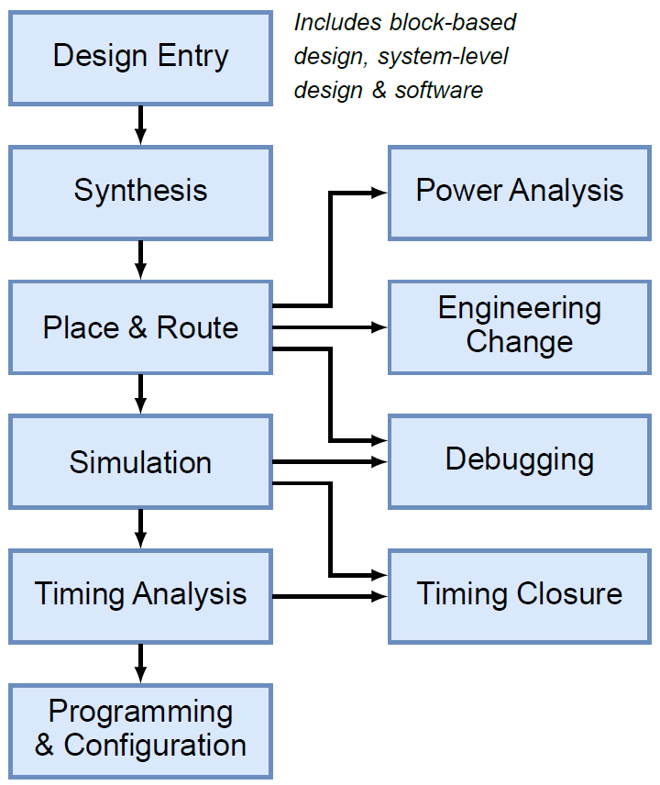
FPGA Design Flow

Slide 10
FPGA Design Flow
10% effort
90% effort

Slide 11
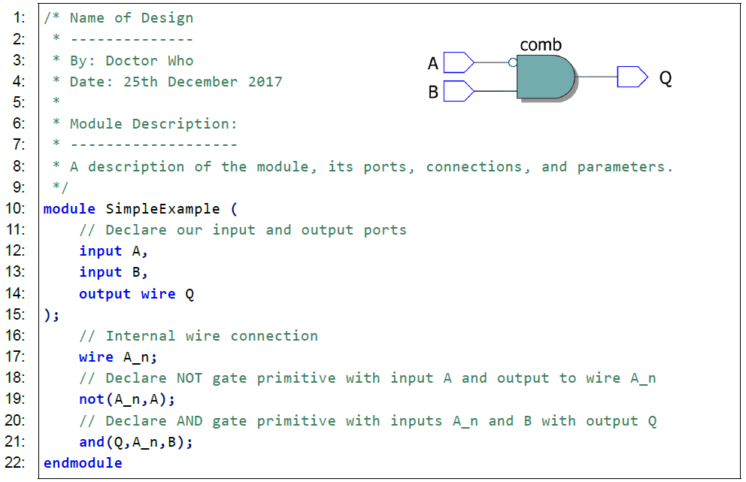
FPGA EDA Tools Gate Level Verilog Design entry

Slide 12
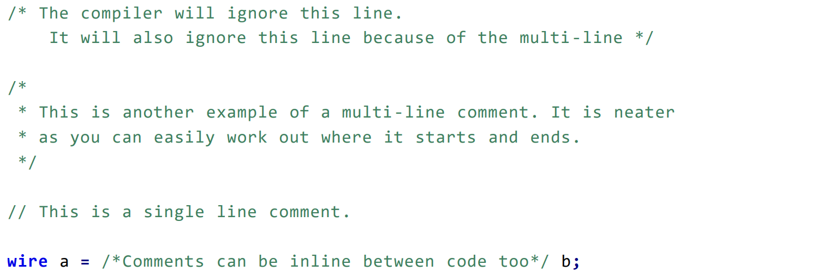
Comments in Verilog

Slide 13
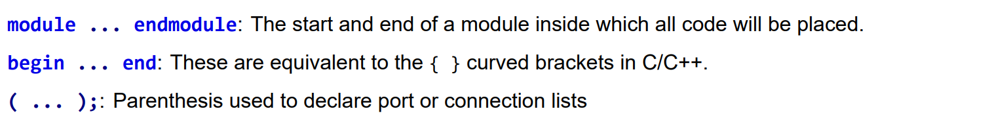
Blocks of code

Slide 14
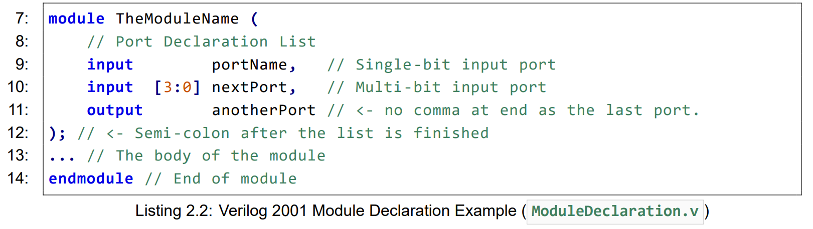
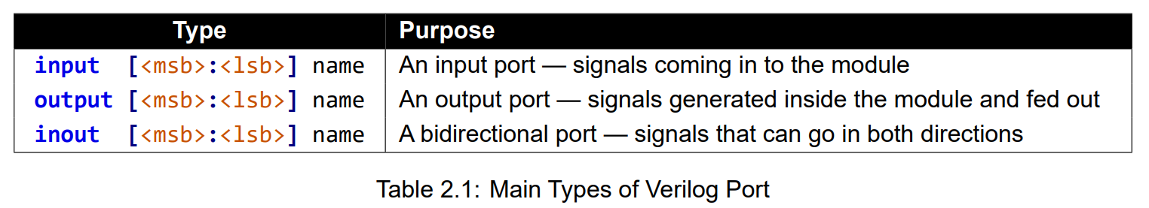
Verilog Modules

Slide 15
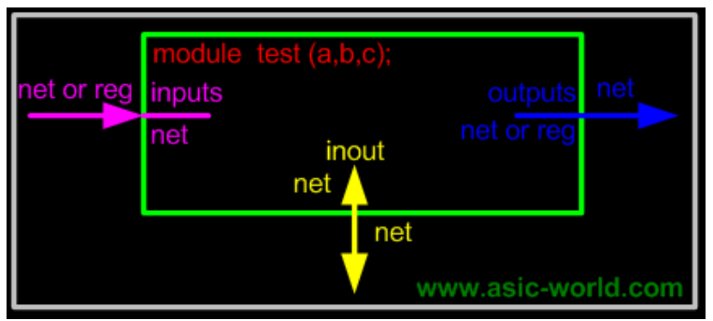
Wires
Wires are used simply to link together parts of a circuit called continuous assignment… …like traces on a circuit board.
Internal to a module by using the wire keyword.
Connections in and out of the module — the output and input ports are implicitly wires

Slide 16
Gate Level Primitives
Single Input
buf (buffer)
not (inverter)
Multiple Input
and
or
xor
xnor
nand
nor
<gate> optionalIdentifier(output, input1, input2, ... );
e.g.
not(A_n,A);
and(Q,A_n,B);

Slide 17
Naming Requirements
Identifiers should be a sequence of letters, digits, underscores (_) and dollar signs ($).
The first character of an identifier can only be a letter or an underscore
iAmAPort
clock50
_something
4bitAdder
star_wars

Slide 18
Naming Requirements
Identifiers should be a sequence of letters, digits, underscores (_) and dollar signs ($).
The first character of an identifier can only be a letter or an underscore
iAmAPort
clock50
_something
4bitAdder
star_wars

Slide 19
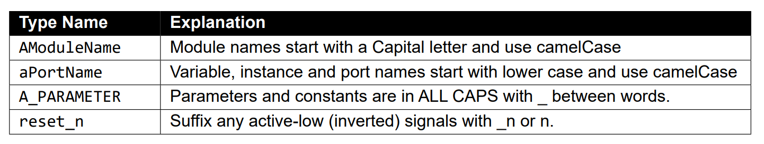
Naming conventions

Slide 20
Gate Level Verilog Full adder example
Cin | A | B | Cout | S
0 | 0 | 0 | 0 | 0
0 | 0 | 1 | 0 | 1
0 | 1 | 0 | 0 | 1
0 | 1 | 1 | 1 | 0
1 | 0 | 0 | 0 | 1
1 | 0 | 1 | 1 | 0
1 | 1 | 0 | 1 | 0
1 | 1 | 1 | 1 | 1

Slide 21
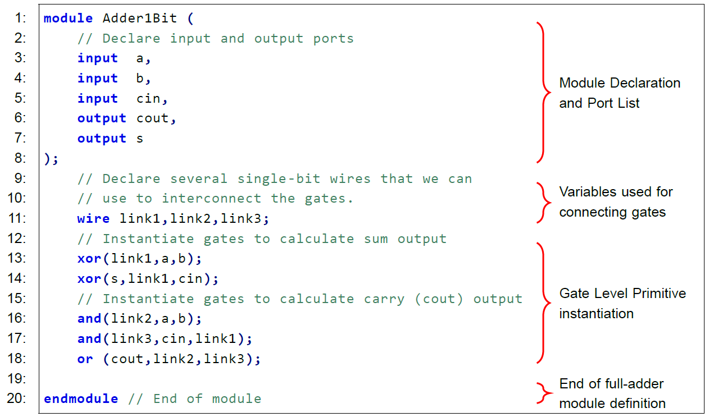
Gate Level Verilog Full adder example

Slide 22
Full adder example

Slide 23
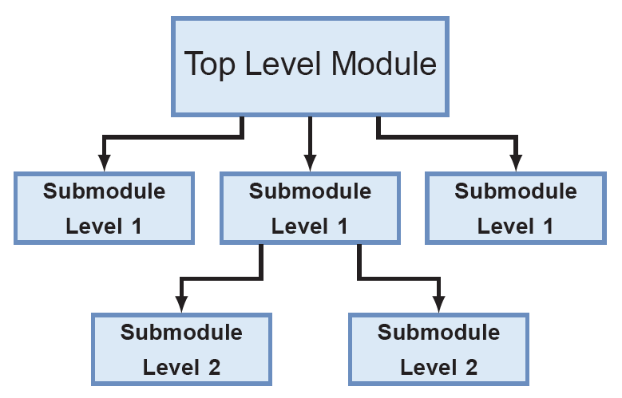
Hierarchy

Slide 24
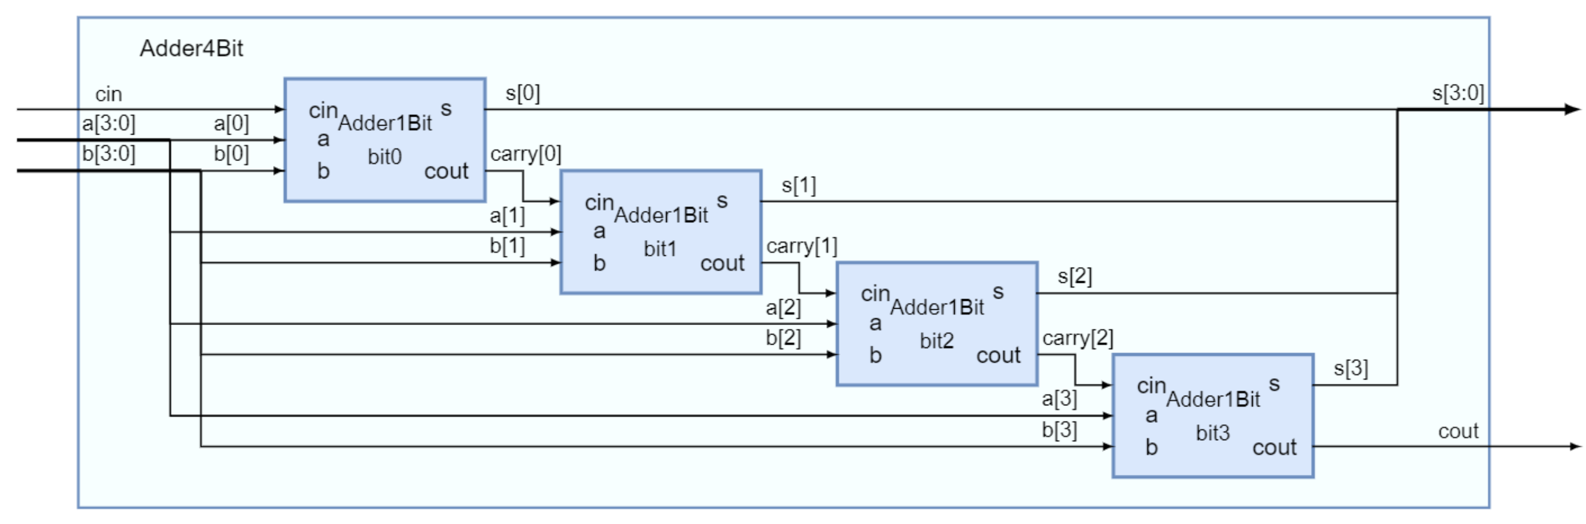
Hierarchical 4-bit Adder using four 1-bit adder modules

Slide 25
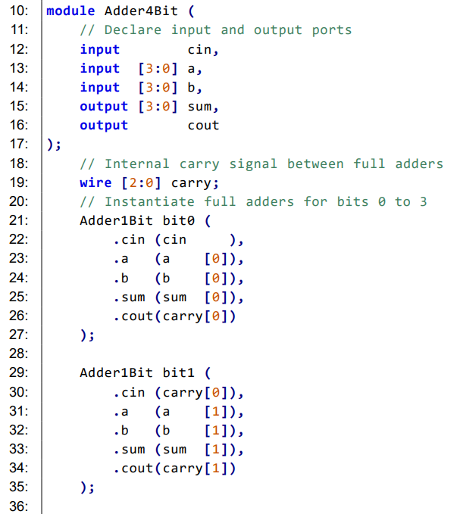
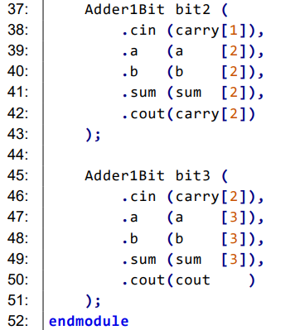
Hierarchical 4-bit Adder using four 1-bit adder modules
Note: We DO NOT copy and
paste the Adder1Bit code

Slide 26
Intel Quartus

Slide 27
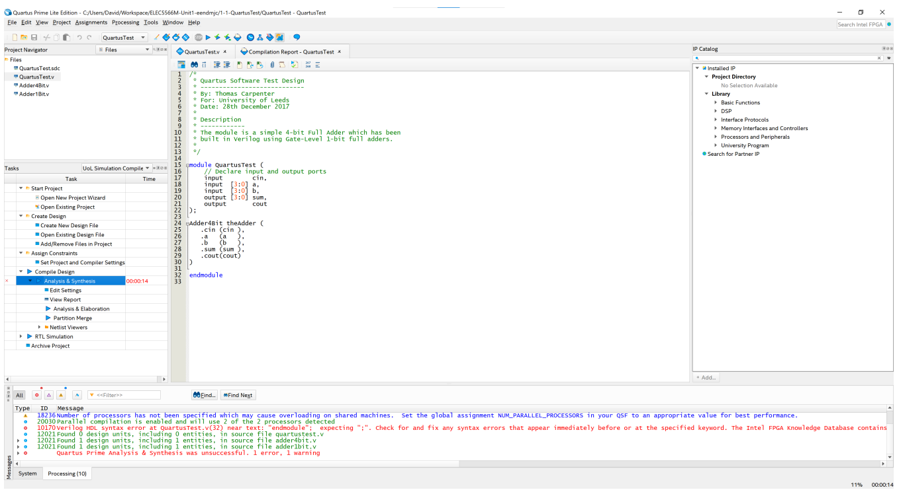

Slide 29
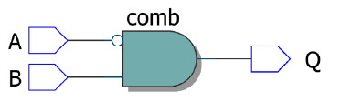
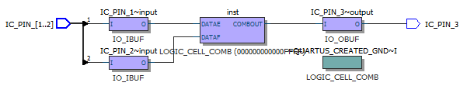
FPGA EDA Tools Synthesis
At compile time EDA suite translates circuit description into optimized Boolean equations
Software includes algorithms to map equations to FPGA hardware in the most efficient way possible to maximise FPGA resource utilisation
EDA suite can then be used to program actual FPGA hardware with compiled design files.

Slide 30
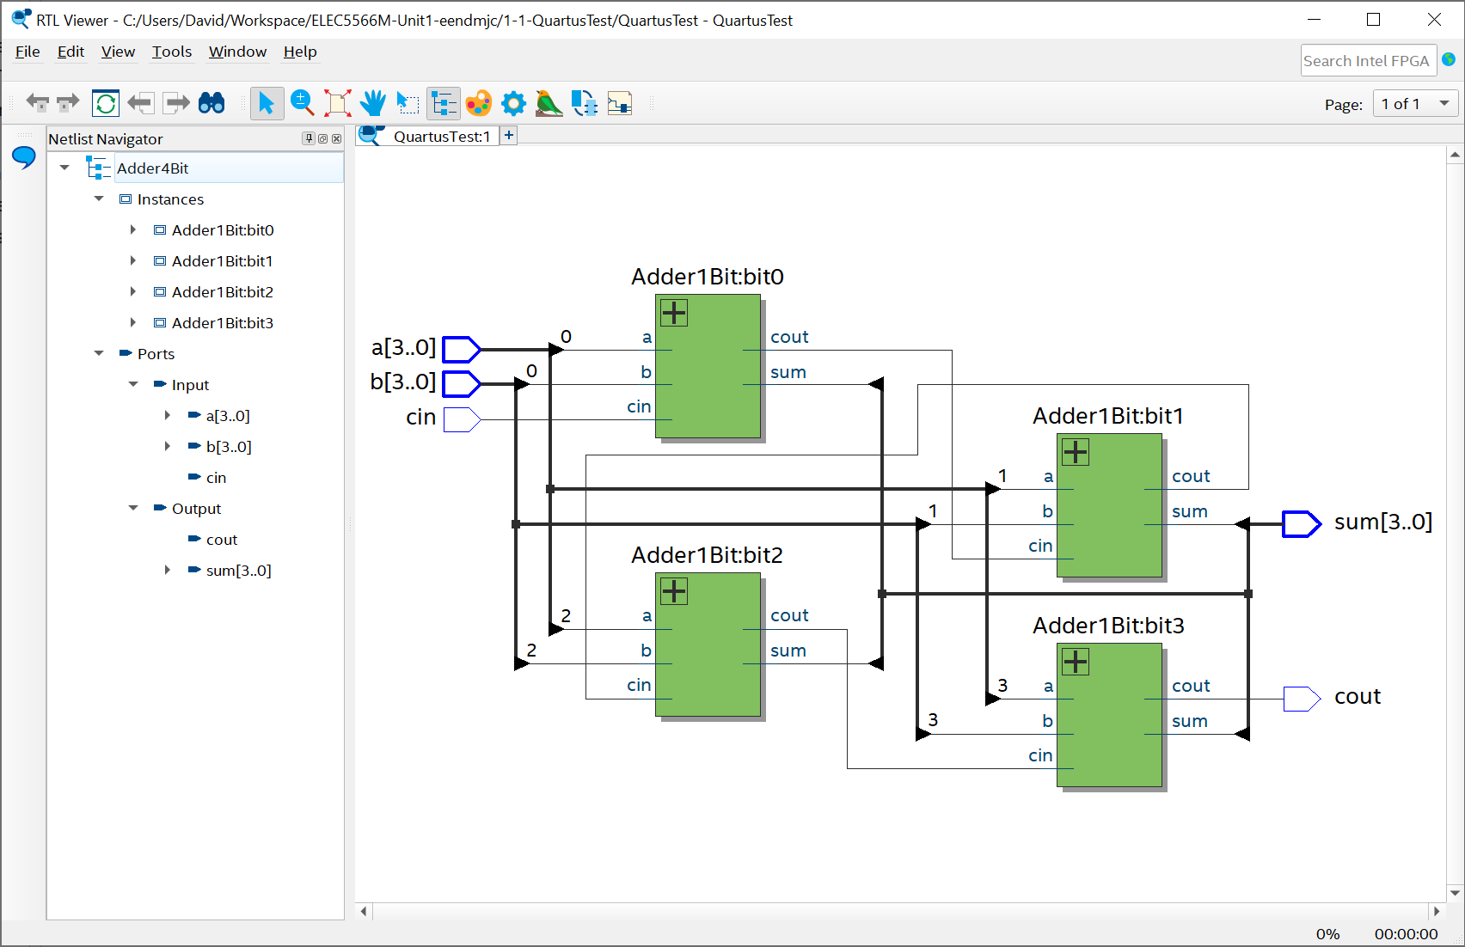
Hierarchical 4-bit Adder using four 1-bit adder modules

Slide 31
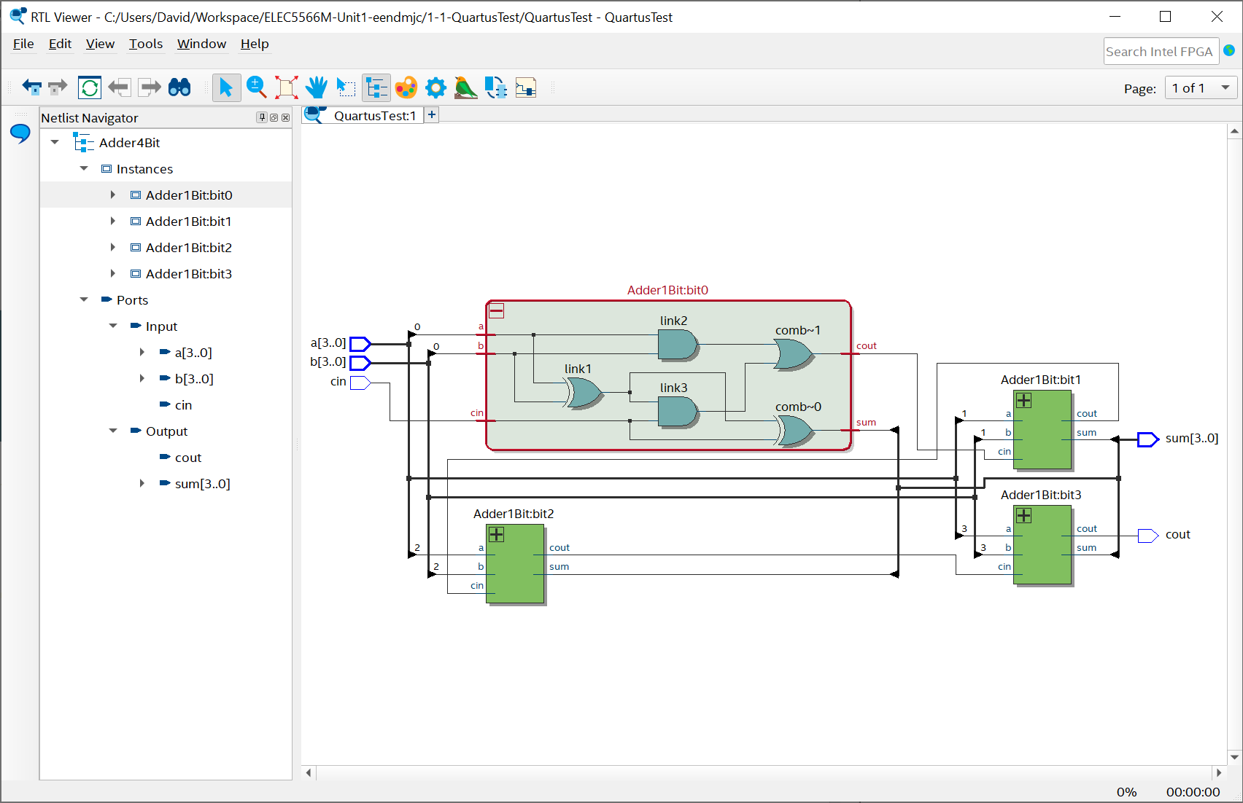
Hierarchical 4-bit Adder using four 1-bit adder modules

Slide 32
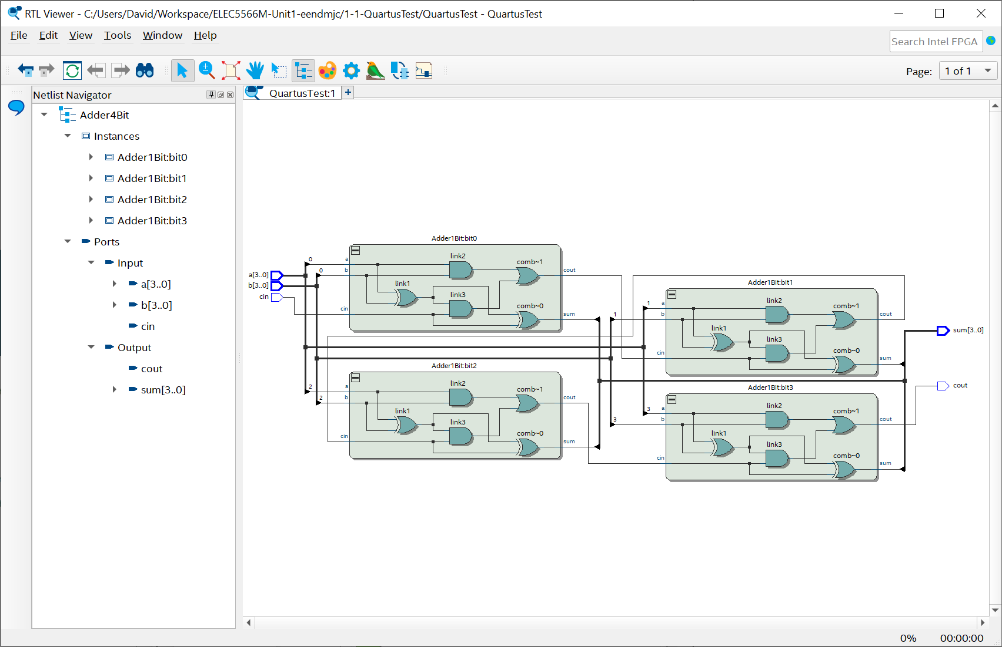
Hierarchical 4-bit Adder using four 1-bit adder modules

Slide 33
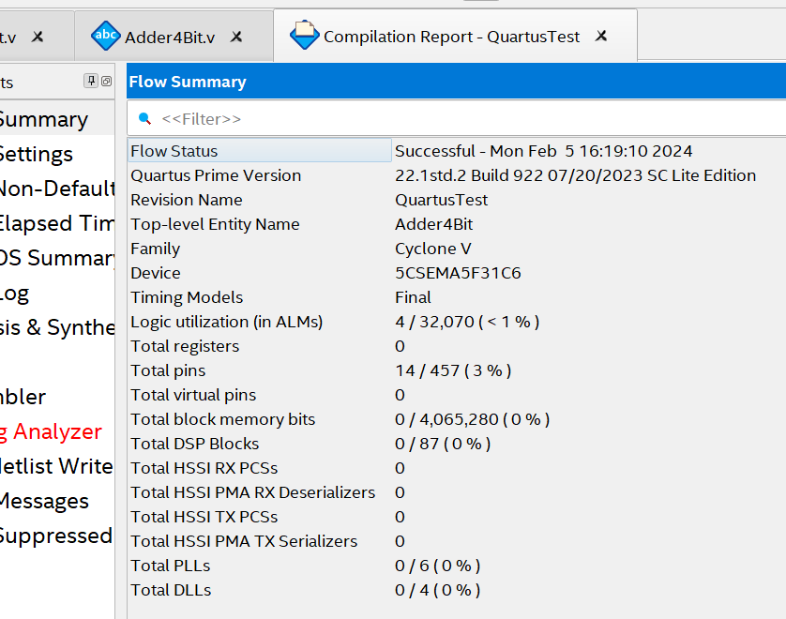
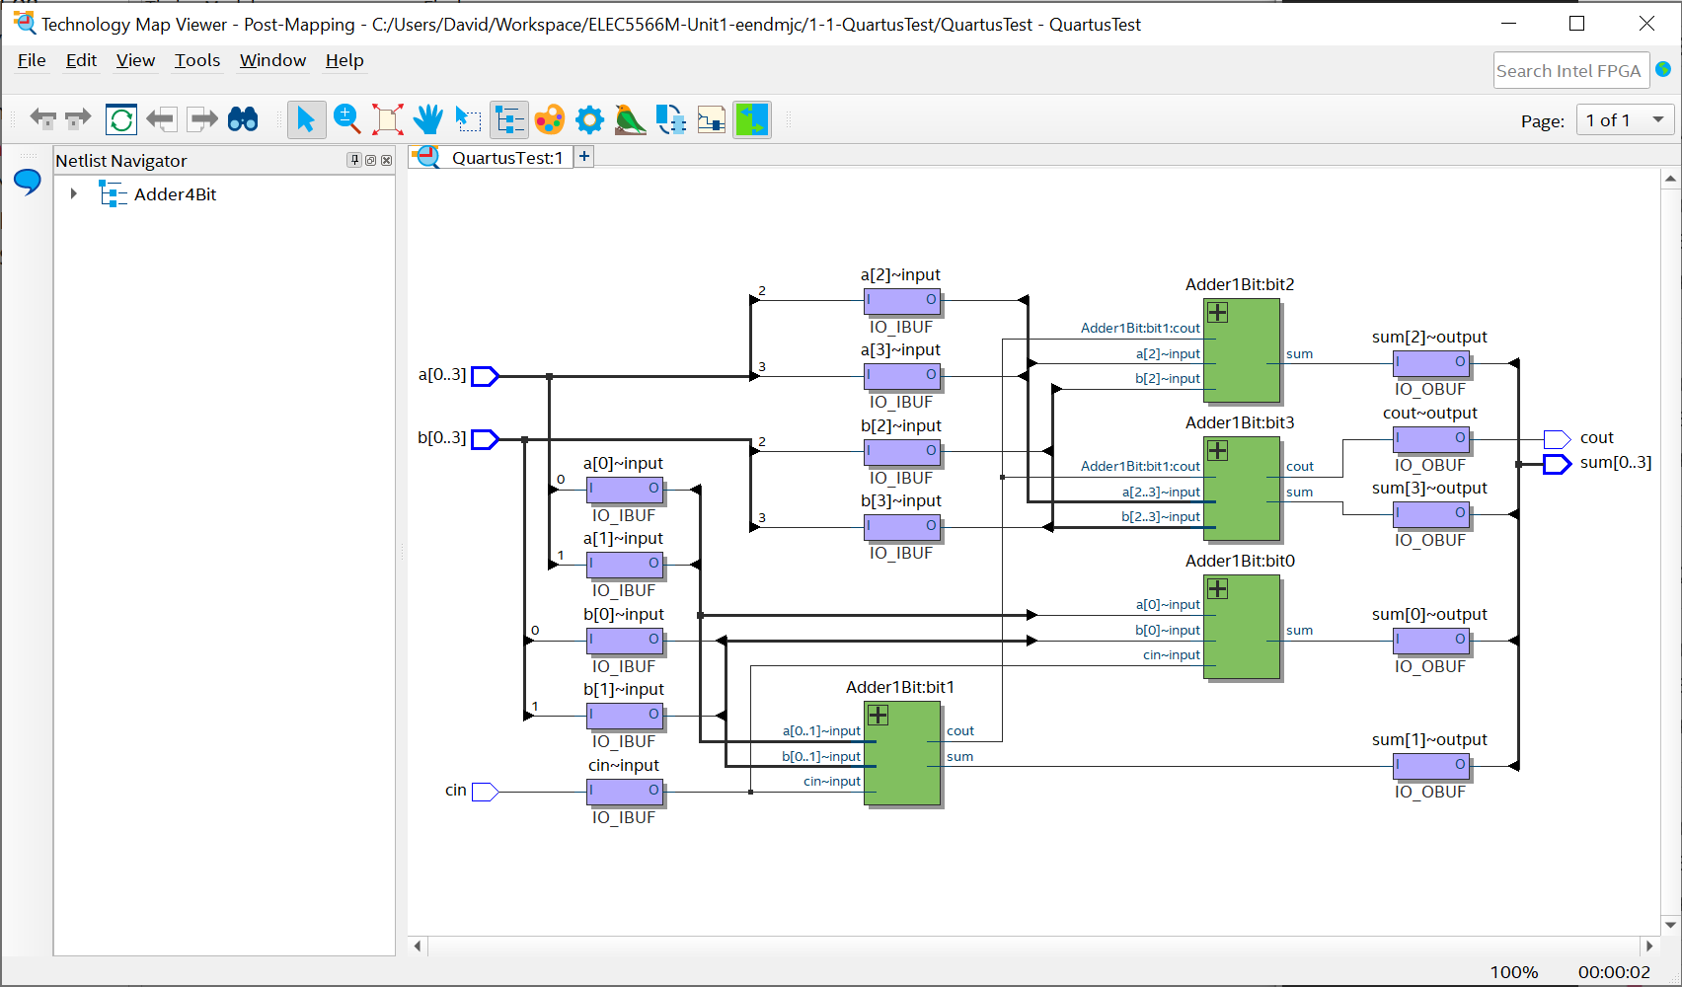
Compilation Report Technology Map Viewer

Slide 34

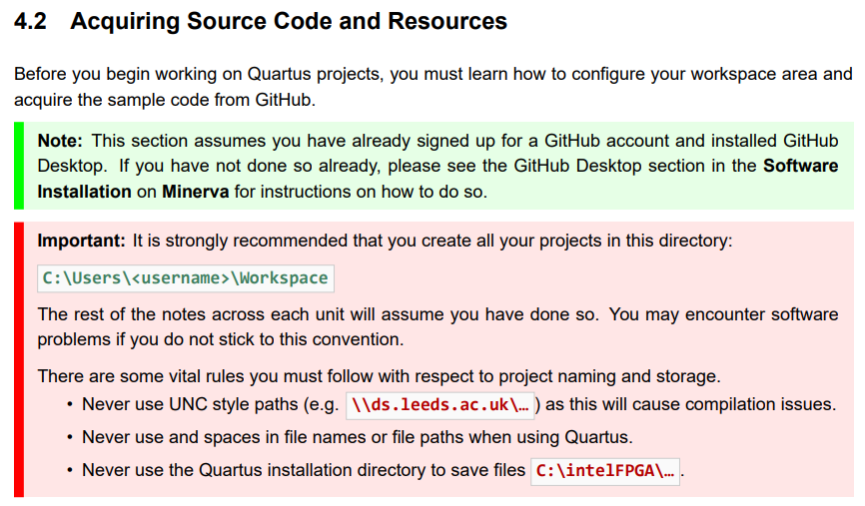
Warning!
GitHub Classrooms: Only select the identifier that matches your username!
Follow instructions carefully… especially usernames, paths & filenames

Slide 35
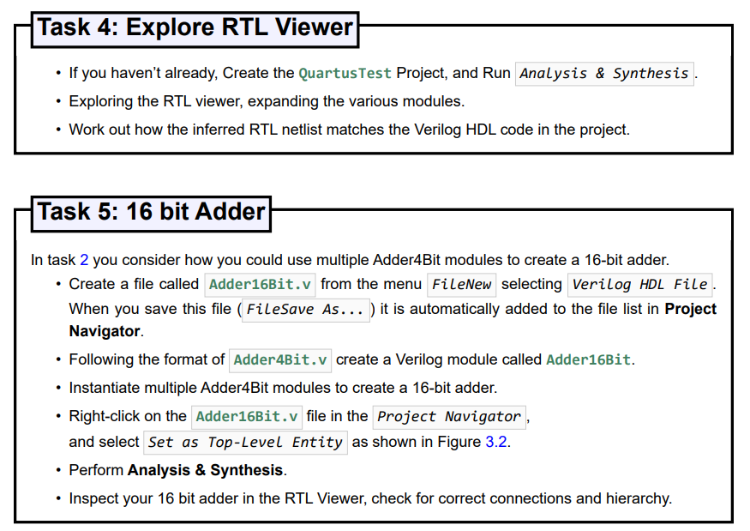
Tasks

Slide 36
Have fun and enjoy the FPGA module!

